Slide 1


Unicorn Companies
Exploratory Data Analysis
BY: IBOR STELLA .A.

Slide 2

Work Plan:
Basic Exploratory Data Analysis of Unicon Companies
Data Inspection and Manipulation
Data Exploration - Findings/Recommensations
Conclusion

Slide 3
Basic Exploratory Data Analysis
importation of the necessary libraries
import numpy as np
import pandas as pd
# for visuals
import seaborn as sns
import matplotlib.pyplot as plt
successful importation of the csv file.

Slide 4
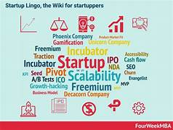
Data Inspection and Manipulation
Checked for :
Duplicates,
Data type,
Missing Values,
Columns,
nunique

Slide 5
EXPLORATORY DATA ANALYSIS
Total count of Unicorn companies(1075), select Investors(1058), Industry(16), Continent(6), Countries(46), Cities(256),valuation and funding
Unicorn companies with the biggest return on investment
Magic Leap, Hello TransTech etc
Company and year founded
Country with the most unicorns; likewise industry hub city - United State for country while San Francisco has the highest city hub,
How long it takes for a company to become a unicorn - The average founding year for unicorn companies is around 2012.9, with a minimum founding year of 1919 and a maximum founding year of 2021, suggesting that there is a wide range in the time it takes for companies to achieve unicorn status, including both long-established and relatively recent entrants.

Slide 6
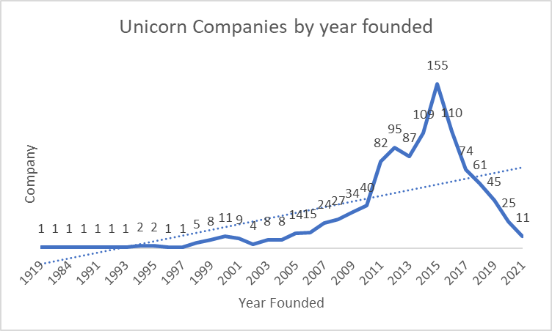
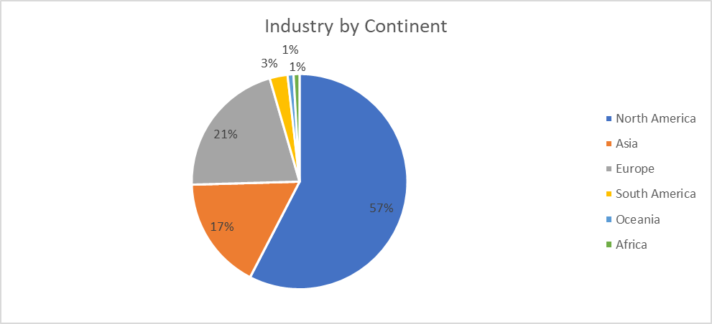
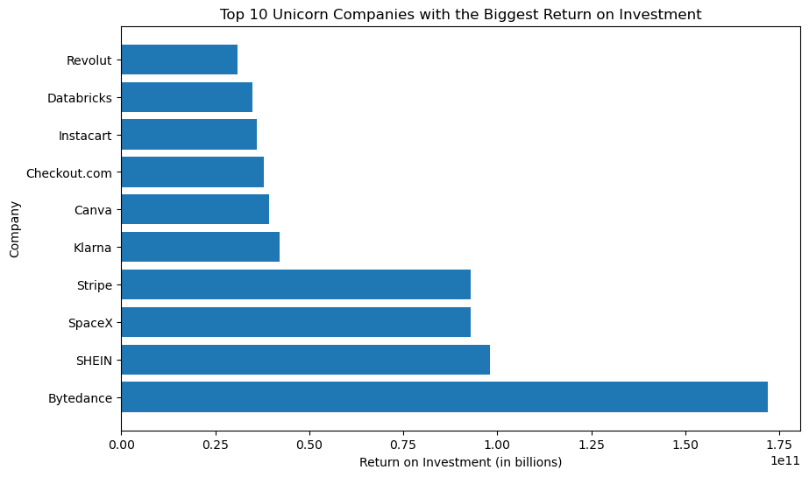
Graphical Representation of Insights

Slide 7
Findings
The dataset shows a list of unicorn companies and their respective funding amounts, continents, and select investors. There is an identification trends in unicorn company funding across different continents, this gives an insight to potential investment on available opportunities. For example:
North America and Asia are the continents with the highest number of unicorn companies, followed by Europe.
The United States, China, and India are the countries with the highest number of unicorn companies.
The unicorn companies are spread across different industries, including technology, e-commerce, finance, and healthcare.
The total funding received by unicorn companies in North America is significantly higher than that of other continents, indicating a robust startup ecosystem in the region.
In Conclusion, the dataset identifies potential investment opportunities in the unicorn space across different continents and industries.

Slide 8

Recommendations
1. Investors looking for potential investment opportunities in the unicorn space may consider North America and Asia as they have the most promising markets based on their high levels of funding.
2. Although Europe received less funding than North America and Asia, it still presents potential investment opportunities for Investors looking to diversify their portfolios.
3. Investors looking for untapped markets may want to explore Africa, Oceania, and South America as potential areas for growth in the unicorn space as wellas the untapped industries.

Slide 9
THANK YOU

